Slide 1
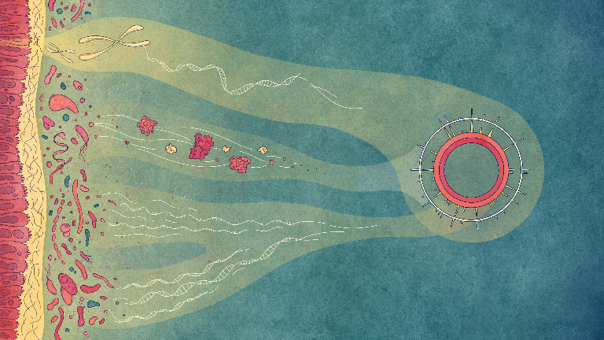





Y a-t-il une connexion entre les intestins
et le système nerveux central ?
Paul Wilmes
@wilmeslab

Slide 2
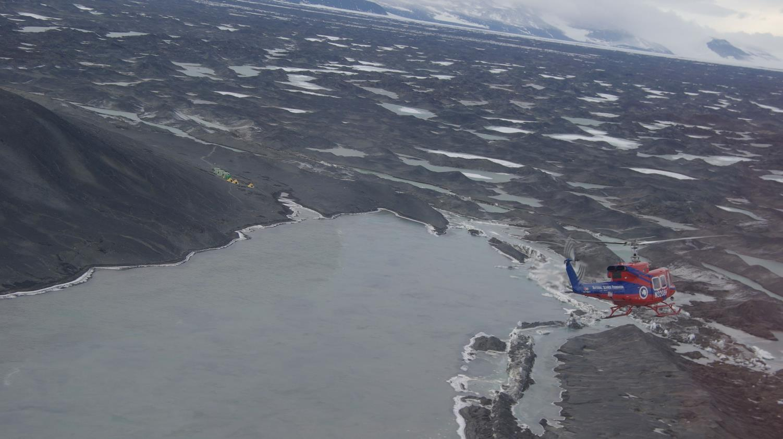
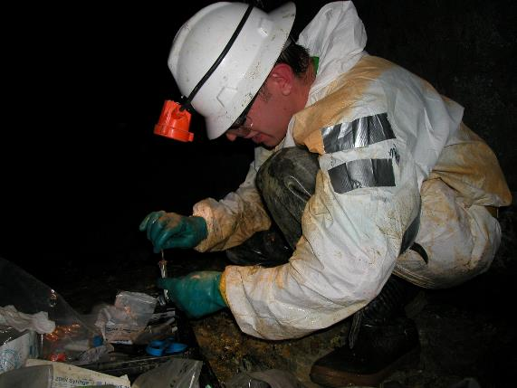
L’étude de communautés microbiennes

Slide 3
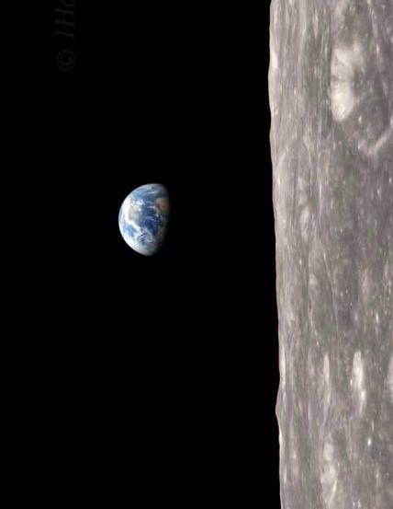
  « Les microbes gouvernent le monde. C'est si simple.
  Bien que nous ne les voyons généralement pas, les microbes sont essentiels pour chaque partie de la vie humaine - en effet, toute la vie sur terre; chaque processus dans la biosphère est touché par la capacité apparemment infinie des microbes à transformer le monde autour d'eux. »
  Board on Life Sciences (2007) The New Science of Metagenomics: Revealing the Secrets of Our Microbial Planet; National Academies Press, Washington DC, USA
Source : http://apod.nasa.gov/apod/image/earthrise_apollo8.gif
Notes:
William Anders
Life on Earth is possible because of microorganisms in the biosphere. This is in stark contrast to other celestial bodies in the Universe (including our own moon). To put it bluntly: “Microbes run the world…” This is from the introduction of the US National Research Council’s report on Metagenomics and has since been published in book form by the National Academy of Sciences. So just to reiterate: the microbial world harbors enormous organismal and metabolic diversity. This extensive diversity awaits its comprehensive exploitation for the benefit of mankind.

Slide 4
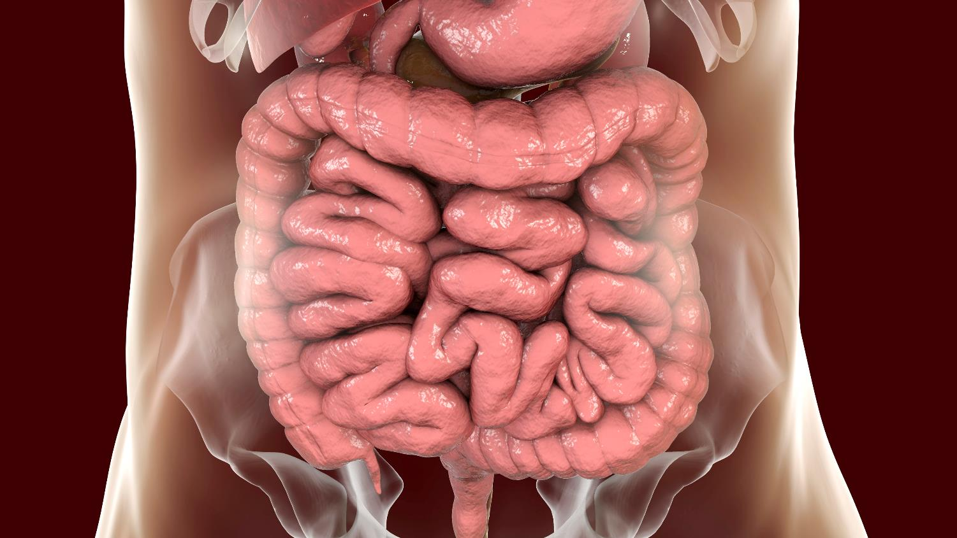
L’écologie de l’invisible

Slide 5
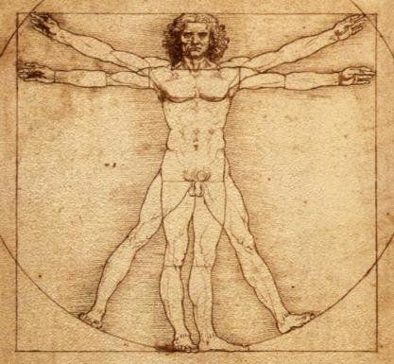
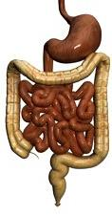
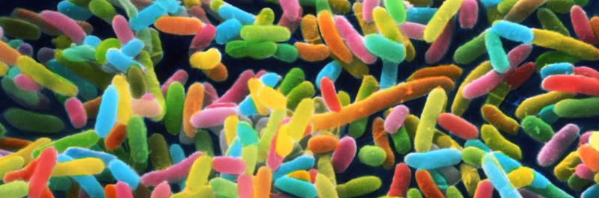
Qu’est-ce que le microbiote humain ?
1-10 x plus de cellules microbiennes que de cellules humaines
100 x plus de gènes microbiens que de gènes humains
Le long du tractus gastrointestinal: 1-3 kg de biomasse microbienne
Un mélange de différentes espèces microbiennes

Slide 6










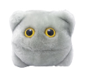





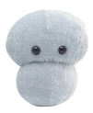












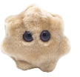
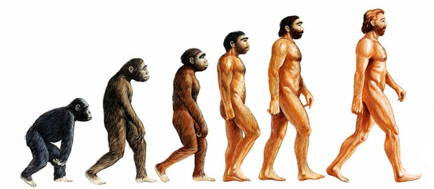
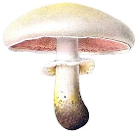
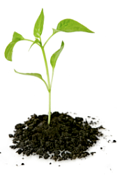
Dans l’intestin humain: environ 1500 types d’espèces microbiennes
© Giant Microbes

Slide 7
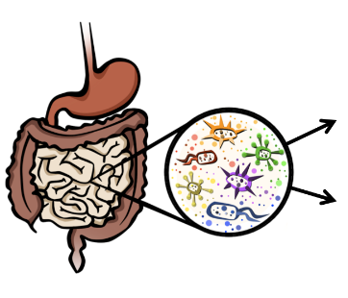
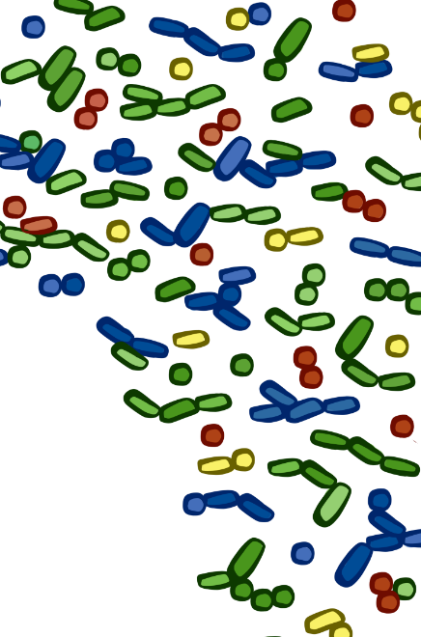
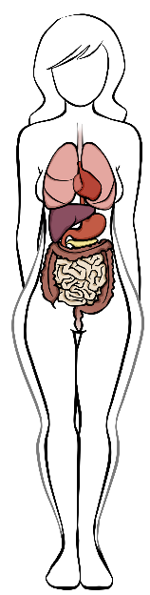

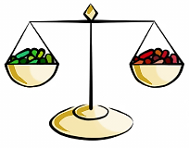
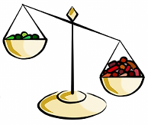
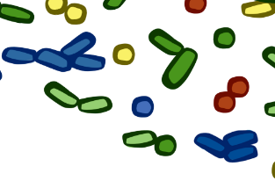

Le microbiote humain
Rôles et fonctions
Maladies
Production d’énergie et de vitamines
Stimulation du système immunitaire
Asthme/Allergies
Athérosclerose
Maladies cardiovasculaires
Cancer du colon
Diabète
Maladie inflammatoire de l'intestin
Maladies neurodégénératives
Obésité
Dysbiose
Intéractions bénéfiques
Inflammation
Notes:
Elie Metchnikoff: lauréat Nobel en 1908.

Slide 8
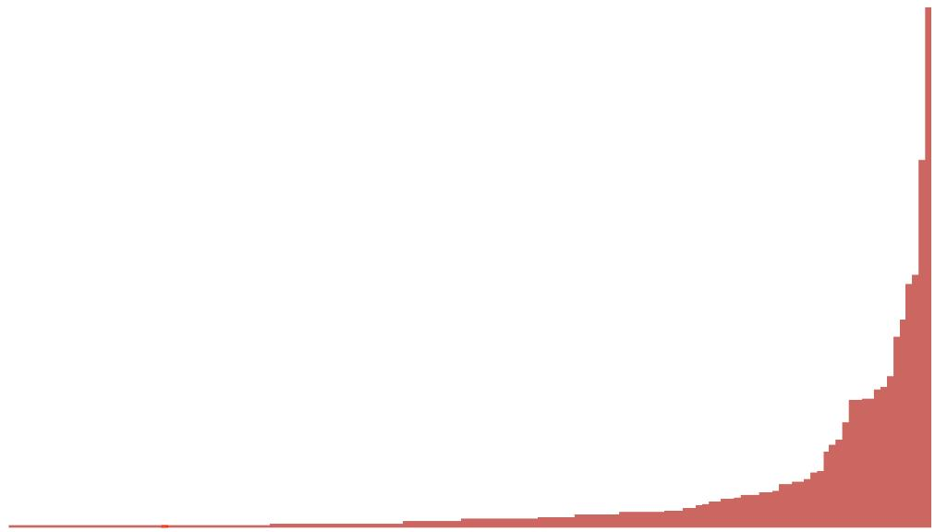
Un microbiote sain
Abondance
Espèces microbiennes par abondance

Slide 9
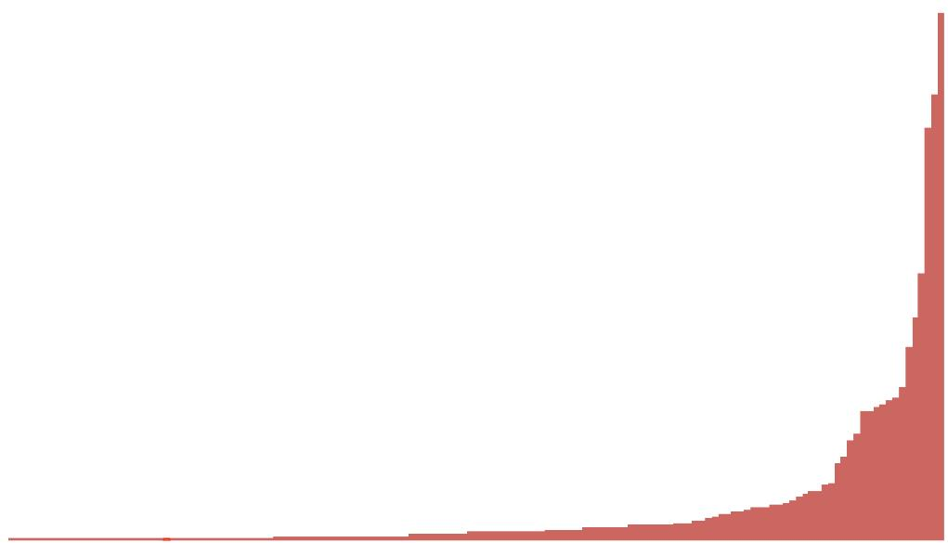
Dysbiose microbienne
Abondance
Moins de biodiversité!
Espèces microbiennes par abondance

Slide 10
La dysbiose microbienne et les maladies chroniques
matières
Santé
Maladie
Production de alimentaires et d’énergie
Obésité et maladies métaboliques
Prévention du cancer
Source de cancer
Inhibition de pathogènes
Stimulation de la croissance de pathogènes
Stimulation du système immunitaire
Inflammation
Motilité gastro-intestinale
Problèmes de motilité gastro-intestinale
Activité cardio-vasculaire normale
Maladies cardio-vasculaires
Fonctionnement normal du système nerveux
Maladies neuro-dégénératives

Slide 11
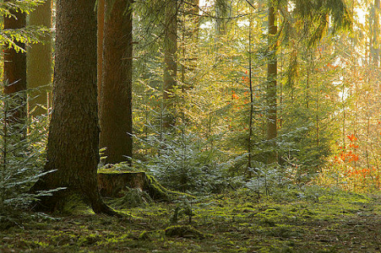
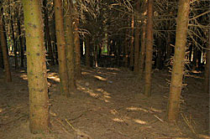
La dysbiose microbienne et la santé humaine
Santé
Maladie
Plus de biodiversité = plus de résilience
Moins de biodiversité = plus de risque de maladies
Cause ou conséquence?

Slide 12
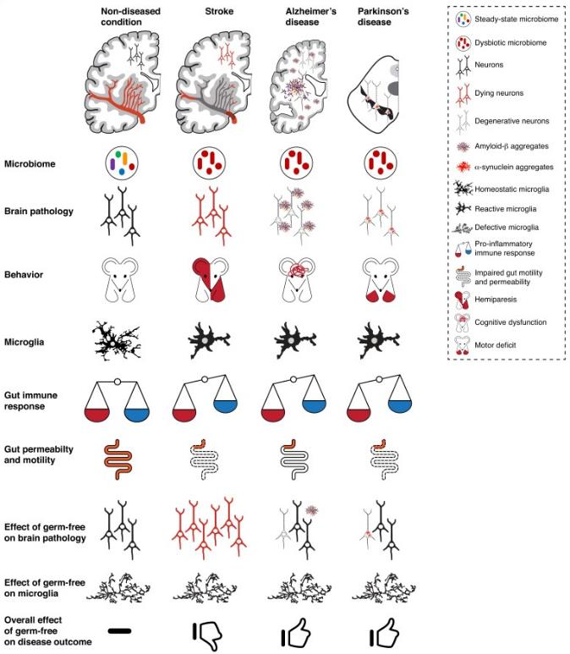
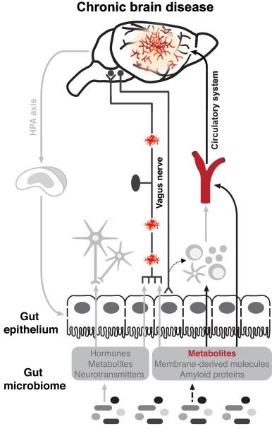
Maladies neuro-dégénératives et le microbiote human
Benakis, …, Wilmes (2020) Current Opinion in Neurobiology 61:1-9.

Slide 13
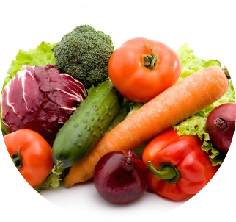
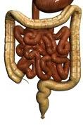
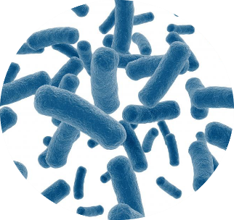
Des interactions écologiques complexes
Intestin
Denrées alimentaires
(fibres)
Gros intestin
(pas d’O₂)
Microbiote

Slide 14

Transformations métaboliques complexes par le microbiote
Hydrates de carbone complexes
Protéines
Hydrogène
Acides biliaires
Amines secondaires
2
Stéroïdes
Xénobiotiques
Phytoestrogènes
Phytoestrogènes convertis
Xénobiotiques transformés
2
Stéroïdes modifiés
Amines nitrosylés
Acides biliaires modifiés
Méthane, acetate, bisulfure
Acides aminés, ammoniac, amines, bisulfure, thiols, phénols, indoles
Acides organiques, acides gras à chaînes courtes
Peisl, …, Wilmes (2018) Analytica Chimica Acta 1037:13-27.

Slide 15
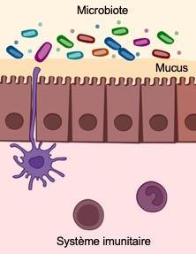

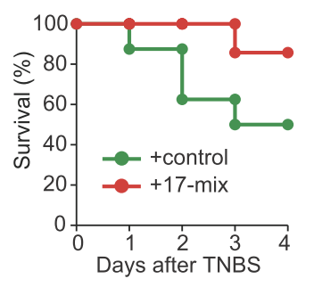
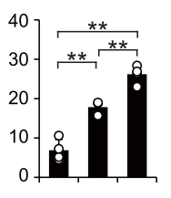
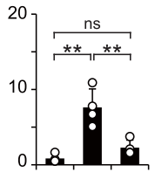
Lien métabolisme microbien et le système immunitaire
Microbiote humain
Mélange de 17-clostridia
Souris sans germes
Survie (%)
% T_{reg}
% Th17
GF
GF
Jours après TNBS
+hu
+hu
+17-mix
+17-mix
Atarashi et al. (2013) Nature 8:232-6.
Notes:
Lymphocytes T régulateur
Létalité

Slide 16
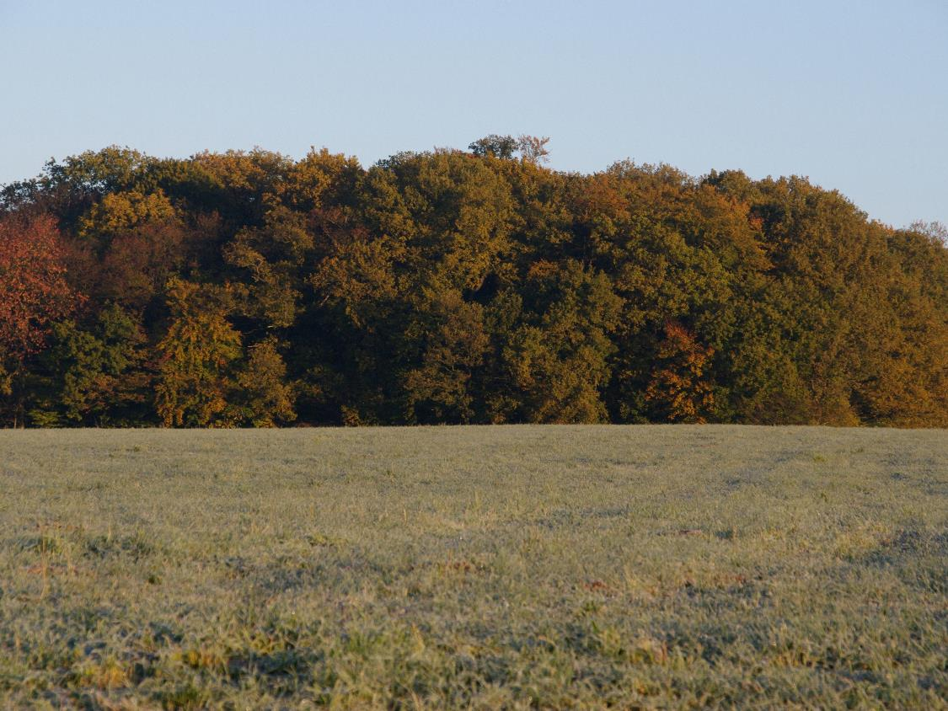

Slide 17
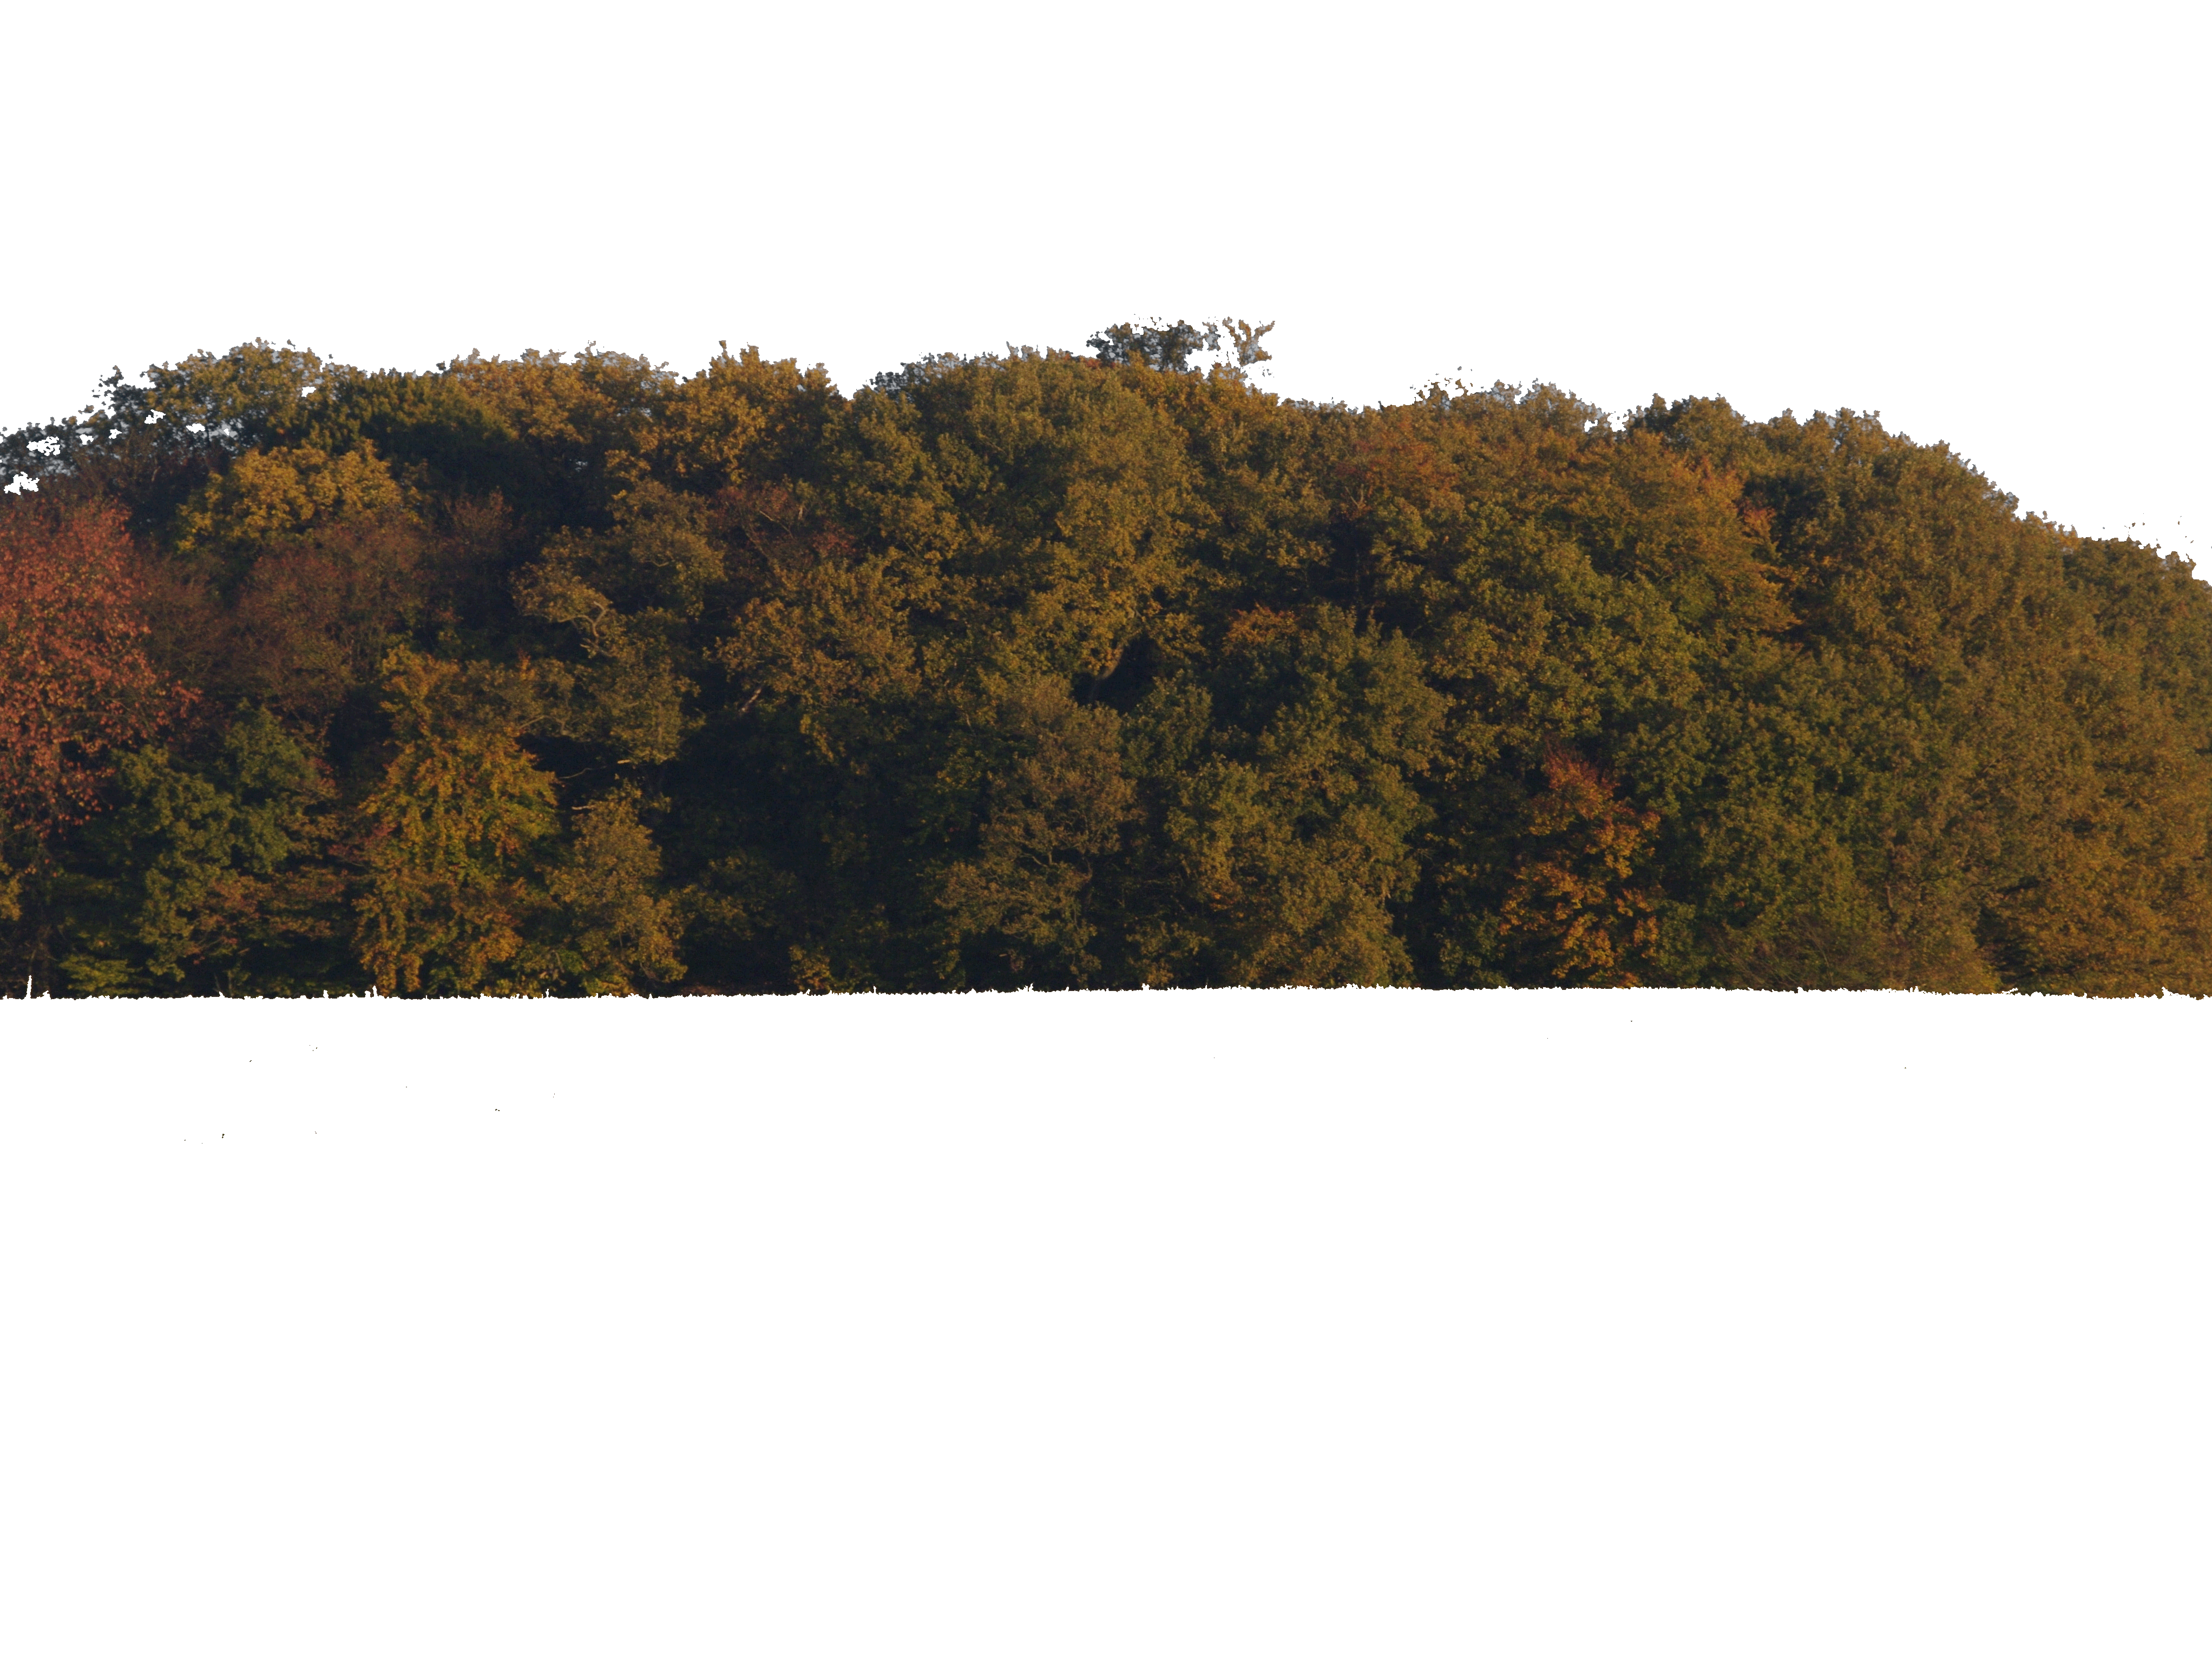

Slide 18
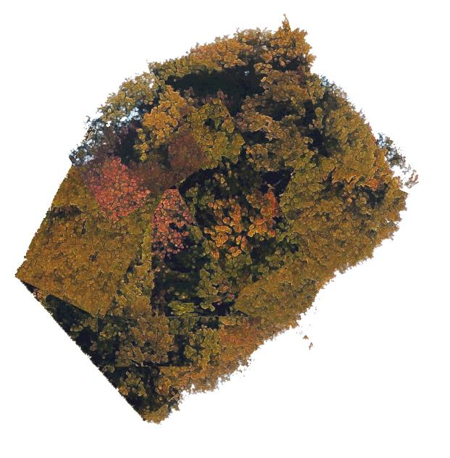
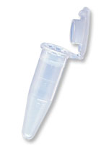
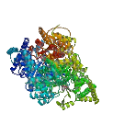

par exemple Quercus quercus ou Quercus robur
Notes:
2 espèces de chêne

Slide 19


par exemple E. coli ou Clostridium sp.

Slide 20
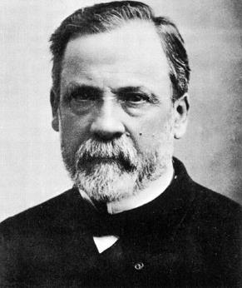
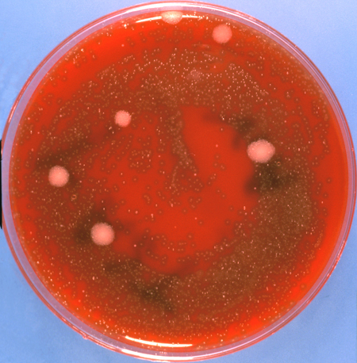
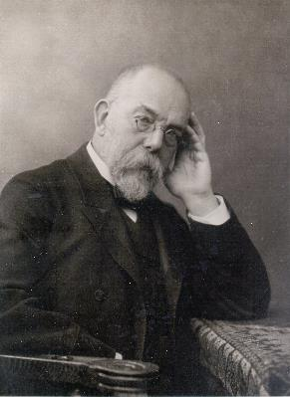
La microbiologie classique
Souches isolées
Louis Pasteur
> 99.9 %
des microbes sont incultivables,
l’écologie ne peut être comprise !
Robert Koch
http://upload.wikimedia.org/wikipedia/commons/4/42/Louis_Pasteur.jpg
http://upload.wikimedia.org/wikipedia/commons/5/55/Robert_Koch.jpg
http://www.ams.cmu.ac.th/mt/clinmcrb/CMBwebsite/CMB%20photo/EMB2.jpg

Slide 21
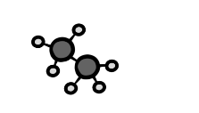
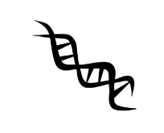

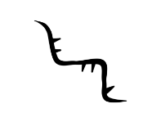
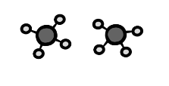

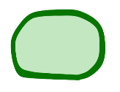
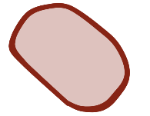

La biologie des écosystèmes
ADN
ARN
protéine
métabolites
meta-génomique meta-transcriptomique meta-protéomique meta-métabolomique
Population A
Population B
Population C
Humain
Muller, …, Wilmes (2018) Current Opinion in Systems Biology 8:73-80.

Slide 22
La biologie des écosystèmes
ADN
ARN
protéine
métabolites
meta-génomique meta-transcriptomique meta-protéomique meta-métabolomique
Population A
Population B
Population C
Humain
Muller, …, Wilmes (2018) Current Opinion in Systems Biology 8:73-80.

Slide 23



La biologie des écosystèmes
ADN
ARN
protéine
métabolites
meta-génomique meta-transcriptomique meta-protéomique meta-métabolomique
Population X
Population B
Population C
Humain
Muller, …, Wilmes (2018) Current Opinion in Systems Biology 8:73-80.

Slide 24

La biologie des écosystèmes
ADN
ARN
protéine
métabolites
meta-génomique meta-transcriptomique meta-protéomique meta-métabolomique
Population A
Population B
Population Y
Population C
Humain
Muller, …, Wilmes (2018) Current Opinion in Systems Biology 8:73-80.

Slide 25


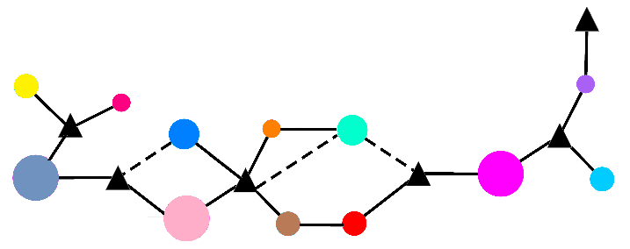


Des réseaux écologiques bouleversés dans le contexte de maladies
Temps
Sain
Malade
Biomolécules
Souches microbiennes

Slide 26



















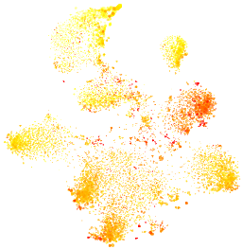
Mesures systématiques
Echantillon
Conservation
Lyse
Extraction
Métabolites
Protéines
ARN large
ARN petit
ADN
Métabolomique
Métaprotéomique
Métatranscriptomique
Métagénomique
Intégration
Brevets: PCT/EP2012/065178;
PCT/EP2013/052134; LU92276.
Roume et al. (2013) Nature, ISME J. 7:110–121.
Roume et al. (2013) Method Enzymol. 531:219–236.
Muller et al. (2014) Nature Comm. 5:5603.
Laczny et al. (2015) Microbiome 3:1.
Roume et al. (2015) Nature, Biofilms Microbiomes 1:15007.
Heintz-Buschart et al. (2017) Nature Microbiology 16180:1-12.

Slide 27
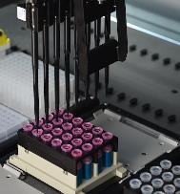





La distillerie de biomolécules: Adam, Lilith & Eva
2
Collaboration with TECAN: high-throughput platform
en collaboration avec

Slide 28

VizBin2.0
https://git-r3lab.uni.lu/anna.buschart/MuStMultiomics
Laczny, …, Wilmes (2014) Nature, Scientific Reports 4:4516
Laczny, …, Wilmes (2015) Microbiome 3:1.
Heintz-Buschart, …, Wilmes (2017) Nature Microbiology 16180:1-12.

Slide 29


Analyses systématiques et reproductibles
IMP
http://r3lab.uni.lu/web/imp
Brevets: PCT/EP2013/052134; LU92276.
Narayanasamy, …, Wilmes (2016) Genome Biology 17:260.

Slide 30




Intégration des données
A
B
reads
variant calling
protein profile
whole human genome
individualized protein sequences
mass spectra
human proteins
metaproteome
protein identification
functional profile
microbial proteins
strain-resolved gene predictions
reads
taxonomic profile
functional profile
metatranscriptome
variant calling
functional annotations
genome reconstructions
assembly
alignment
gene predictions
reads
taxonomic profile
functional profile
metagenome
binning
mOTU marker genes
detected mOTU marker genes
functional categories
Heintz-Buschart, …, Wilmes (2017) Nature Microbiology 16180:1-12.
Notes:
include viral stuff

Slide 31
Intégration des données
Muller, …, Wilmes (2014) Nature Communications 5:5603.

Slide 32
Le microbiote humain et la maladie de Parkinson
La vagotomie tronculaire diminue le risque de maladie
Le système nerveux entérique présente des inclusions de corps de Lewy dès le début
Deux voies d'entrée possibles : cavité nasale et/ou intestin
microbiote
énergie
système
immunitaire
Braak et al. (2006) Neuroscience Letters 396: 67-72.
Benakis, …, Wilmes (2020) Current Opinion in Neurobiology 61:1-9.
Notes:
In the brain, PD appears to start in the brain stem (dorsal motor nucleus of the vagal nerve) and advances through susceptible regions of the basal mid- and forebrain until it reaches the cerebral cortex. Furthermore, during presymptomatic stages of PD, inclusion body pathology is also seen in olfactory bulb/anterior olfactory nucleus. Olfactory dysfunction and RBD accompany the nigrostriatal degeneration. These observations suggest that an hitherto unknown infectious pathogenic agent may enter the brain via the nasal cavity and/or gastrointestinal tract and cause the ascending pathological process.
rotenone in gut lumen of mice -> spreading of aggregates observed from periphery to CNS
olfactory bulb neurotoxin delivery via dopaminergic nerves from SN
-> toxins

Slide 33
Le microbiote humain et la maladie de Parkinson
healthy (n= 78)
Parkinson’s disease (n= 76)
Heintz-Buschart, …, Wilmes (2018) Movement Disorders 33:88-89.

Slide 34



Microbiote fonctionnel : érosion du mucus et pathogenèse
Rosario et al. (2021) Cell Reports 34:108807.
+ “toxine”
= Parkinson
Desai et al. (2016) Cell 167:1339–1353.

Slide 35


Érosion du mucus et pathogenèse induites par l'alimentation
*
Substantia nigra pars compacta
Pedunculopontine nucleus
*
Dorsal striatum
Locus
coeruleus
Mouvement et coordination
Pons
Différences significatives dans les régions cérébrales sensibles et la coordination en raison de la privation de fibres
Résultats analogues dans d'autres études récentes
[Sampson et al. (2020) eLife 9:e53111]
La privation de fibres aggrave la neuro-dégénération
Time difference (s)
of latence of touch and latence of removal
Schmit et al., données non publiées.
Notes:
dSTR, dorsal striatum; SNpc, substantia nigra pars compacta
CNS PATHOLOGY
CNS pathology is characterised by significant differences in the dorsal striatum and the substantia nigra especially for curli treated groups (DETAIL: in the presence of human alpha synuclein). However, diet does exacerbate the already pronounced neurodegenerative phenotype. Further, fibre deprivation appears to influence the accumulative process of phosphorylated alpha-synuclein in (DETAIL: human alpha-synuclein) transgenic animals as it does neurodegeneration in comparison. Other PD-relevant regions do not show such significant differences, do however follow a similar pattern of variation between the different treatment groups.
COORDINATION
The exacerbated pathological phenotype due to dietaery fibre deprivation and curli especially in transgenic animals is reflected in worsening movement deficits in certain animals. Half of transgenic animals that underwent the combined treatment showed increased time difference from latence of touch to latence of removal in the sensori-motor test called adhesive removal. Our results are analoguous to what has been shown by Sampson et al. (2020), with the big difference that our model had a complete native microbiome. → might be better to leave out the comparison to sampson: 1. different mouse strain, 2. germ free mice, 3. mono-colonized with e.coli, 4. different age, 5. different transgenic line, and there are probably more differences.

Slide 36







Across the omes: Small molecule differences in Parkinson’s disease
Métabolite inconnu
Validation
RI 1109
50 contrôles sains
30 patients prodromiques
50 patients parkinsoniens
Ctrl
prodrome
PD
ID: 2-hydroxypyridine
Brit Mollenhauer
Wolfgang Oertel
Trezzi, Aho et al., données non publiées.
Brevets: LU16908, LU16901.
Notes:
(the actual numbers in present analyses are 49 control subjects, 27 iRBD, and 47 PD patients, but you can give the nice round 50, 30 and 50 because that was correct initially before additional exclusion details were known)

Slide 37








2-HP déclenche les caractéristiques moléculaires de la maladie de Parkinson
Agrégation de l’α-synucléine dans le modèle HiTox de levure
Agrégation de l’α-synucléine dans des neurones entériques
RI 1109
0 mM
30 mM
SNCA
SNCA Filament
Untreated
60μM 72h
60μM 120h
***
Trezzi, Aho et al., données non publiées.
Brevets: LU16908, LU16901.

Slide 38
2-HP et l’activation du inflammasome NLRP3
  Exposition de macrophages murins dérivés de la moelle osseuse au 2-HP
L'incubation jusqu'à 24h augmente le taux d'IL-1β (pro-inflammatoire)
L'effet est inversé à 72h
Trezzi, Aho et al., données non publiées.
Brevets: LU16908, LU16901.
Notes:
(Alternatively you can just leave out the microglia since that is a bit counterintuitive, but it is kind of interesting.)

Slide 39
Résultats préliminaires in vivo
Control PBS
Daily Monitoring of the mice
WT (n=20)
2-HP 5 mM
Euthanasia
Day 0
Day 11
2 months
2-HP 100 mM
Brain collection
Behaviour :
Clasping
Grip strength
Adhesive removal
Intrastriatal
injection
Neuropathology :
αSyn / phospho αSyn
TH / DAT
Microglia
Astroglia
Control PBS
hSNCA (n=20)
2-HP 5 mM
2-HP 100 mM
n=10-14
n=12-15
n=12-15
Trezzi, Aho et al., données non publiées.
Brevets: LU16908, LU16901.

Slide 40


La source de 2-HP
  Les niveaux sont en correlation avec Methanobrevibacter smithii (archée)
  Deux sources proables: metabolite d’archées (et/ou degradation de pesticides)
  Extracellulaire
  Intracellulaire
Shima et al. (2015) Nature Chemistry 7:995–1002.
% of samples containing archaeal enzyme
 | Ctrl | PD | prodrome
Meta-genome | 36.73 | 48.94 | 40.74
Meta-transcrip-tome | 40.82 | 51.06 | 48.15
Trezzi, Aho et al., données non publiées.
Brevets: LU16908, LU16901.
Notes:
(Figure updated to include first and second experiment data. Both experiments show points which represent means of technical replicates. This looks less dramatic but is more accurate, because the old version for the first experiment was a boxplot where each box actually only contained three points, reflecting three technical replicates.)

Slide 41



L’arbre de vie
Carl Woese
http://www.origin-of-mitochondria.net/wp-content/uploads/thebigtree.jpg
http://en.wikipedia.org/wiki/File:Carl_Woese.jpg
Notes:
One of the most important insights gained in biology in the past decades was obtained by Carl Woese and his colleagues including Norman Pace who applied their fundamental insights into the diversity of life to the natural world. These individuals along with others were able to demonstrate that when we think about the diversity of life on the planet, we are really talking about a microbial world whether we call these microorganisms bacteria, archaea or eukaryotes. When one looks at the tree of life, one sees that all organisms are somehow related and unified by common traits. An essential common trait is the need to synthesise proteins using nucleic acid, i.e. mRNA, templates. This occurs in ribosomes and these require ribosomal RNA to translate messenger RNA into protein. Because this is a very conserved and universal molecule, Carl Woese figured that it would represent an ideal molecular chronometer that we can employ to look at the evolutionary relatedness of organisms and which we can use to reconstruct such a phylogenetic tree of life. Importantly, when one now looks at the organisms which are visible with the naked eye, one realises that these organisms only form a small part of the overall tree of life and everything else is microbial.
Now an important point to stress is that all of the metabolism which occurs on our planet is microbial including the metabolism which we perform in the cells of our bodies. In particular, the mitochondrion which represent the "cellular power plants" because they generate most of the cell's supply of ATP are ancient alphaproteobacterial cells which invented the ability to carry out oxidative phosphorylation which was brought into symbiosis with a different type of cell and in the course of time evolved into the organelle which we know today. Similarly, the chloroplast in plants was a former cyanobacterial cell which became a plastid within a cell thereby capable of photosynthesis.
Mitochondrion:
Order: Rickettsiales
Closely related to Pelagibacter ubique, the most dominant bacterium on Earth
Chloroplast:
Cyanobacterium
Everything comes back to organisms making a living (metabolising) in ways which are quite amazing.

Slide 42
PathoFact
Pipeline pour la prédiction des facteurs de virulence et des gènes de résistance antimicrobienne dans les données métagénomiques
Parkinson’s disease
invasin
https://pathofact.lcsb.uni.lu
de Nies, …, Wilmes (2021) Microbiome 9:49.
Notes:
Invasins linked to Enterobacteriaceae (Salmonella/Shigella).

Slide 43

Mécanisme pathogène combinatoire(?)
Trezzi, Aho et al., unpublished.

Slide 44

La sclérose en plaques
  Maladie auto-immune qui affecte le système nerveux central
  Dysfonction du système immunitaire y entraine des lésions qui provoquent des perturbations motrices, sensitives, cognitives, visuelles ou encore sphinctériennes (le plus souvent urinaires et intestinales)
Source : https://institutducerveau-icm.org/wp-content/uploads/2019/11/systeme-nerveaux-sclrose-en-plaques.png

Slide 45

La sclérose en plaques et le microbiote intestinal
  Dysbiose apparente dans le contexte de la maladie
  Augmentations d’Akkermansia et de Methanobrevibacter (👉🏻 Parkinson)
  Corrélées avec différents marqueurs immunologiques
  Effet des traitements de la maladie
Jangi et al. (2016) Nature Communications 7:12015.

Slide 46

Modèle d'intestin expérimental conceptualisé
?
?
Fritz, …, Wilmes (2013) Microbiome 1:14.
Notes:
An idealized in vitro system would look like this: Human and bacterial cells should be grown in two different microfluidic channels that are separated by a semipermeable membrane.. As human cells require oxygen, they would require an oxygenated medium whereas the microbial chamber should be able to contain mixed microbial communities. As human intestine mainly harbors anaerobic bacteria, it would be necessary to have anaerobic medium in the microfluidic channel harboring such communities. Moreover, as our intestine faces a continuous flow of nutrients and liquids, it would be required to have a continuous flow of both the mediums. This will also mean that the human cells will be fed from the basal surface, which better mimics the situation in the intestine and their apical surface facing the gut microbial communities. Previous studies have shown that when human cells are fed from the basal end as opposed to the apical end (e.g. in petri dishes), they grow much faster… Based on this entire logic.. We have developed our microfluidic based system called Humix
Iniitially to determine culture conditions we simulated O2 concs to determine in particular flow rates.The latest flow rates from the model to establish a uniform gradient are 100 ul/min for the perfusion chamber and 5 ul/min for the microbial chamber. These are both quite fast, but otherwise we have a hard time maintaining the same gradient throughout the device. It may be that we eventually decide having a variable gradient along the length of the spiral is physiologically relevant and not a problem.

Slide 47

HuMiX: Human-Microbial X-talk
Caractéristiques essentielles
☑ | Co-culture à proximité
☑ | Incorporation de la couche de mucus
☑ | Culture d'anaérobies stricts et facultatifs
☑ | Gradients (oxygène et nutriments)
☑ | Surveillance en ligne
☑ | Compatible avec les analyses à haut débit
☑ | Recapitulation des données in vivo
☑ | Incorporation de plusieurs types de cellules
☑ | Intégration de cellules primaires
1 cm
Fritz, …, Wilmes (2013) Microbiome 1:14.
Shah, …, Wilmes (2016) Nature Communications 7:11535.
Giolla Eain, …, Wilmes (2017) Engineering 3:60-65.
Wilmes et al. (2018) Current Opinion in Microbiology 44:28-33.
Lucchetti , …, Wilmes (2021) Current Opinion in Endrocrine and Metabolic Research, in press.
Greenhalgh*, Baginska*, …, Wilmes (2021) in preparation.
& unpublished.
Patents: PCT/EP2013/055712, PCT/EP2013/065718 , PCT/EP2013/056607, PCT/EP2016/062024, EP2016/062024, EP18206858.5
Notes:
SLIDE IMMUNOHUMIX

Slide 48



Validation expérimentale – causalité et mécanisme
Modèle
le modèle HuMiX
Brevets: PCT/EP2013/055712; PCT/EP2013/056607; PCT/EP2013/065718; US62/166,940.
Fritz, …, Wilmes (2013) Microbiome 1:14.
Shah, …, Wilmes (2016) Nature Communications 7:11535.
Giolla Eain, …, Wilmes (2017) Engineering 3:60-65.
Wilmes et al. (2018) Current Opinion in Microbiology 44:28-33.

Slide 49




Prébiotiques
(fibres)
Probiotiques
... effets sur les différents stades du cancer de colon
I
IV
Stade
III
II
Greenhalgh, …., Wilmes (2019) Cell Reports 27:1621-1632.
Patent: EP18206858.5

Slide 50




neuroHuMiX – Organ-on-chip model
iPSC-derived enteric neurons in cell culture
MAP2
aSyn
VIP
Hoechst
TUJ1
TH
Hoechst
iPSC-derived enteric neurons in HuMiX
TUJ1
aSyn
DAPI
TUJ1
aSyn
DAPI
iPSC-derived ENS on HuMiX PC lid
Inclusion de neurones entériques
Mao et al. (2020) Microbiome 8:53.

Slide 51


Des millions de biomolecules différentes
30-90 % inconnues
Immunogénicité inconnue

Slide 52
  Le microbiote
  un nouvel horizon
Source : http://apod.nasa.gov/apod/image/earthrise_apollo8.gif
Notes:
William Anders
Life on Earth is possible because of microorganisms in the biosphere. This is in stark contrast to other celestial bodies in the Universe (including our own moon). To put it bluntly: “Microbes run the world…” This is from the introduction of the US National Research Council’s report on Metagenomics and has since been published in book form by the National Academy of Sciences. So just to reiterate: the microbial world harbors enormous organismal and metabolic diversity. This extensive diversity awaits its comprehensive exploitation for the benefit of mankind.

Slide 53



























Brit Mollenhauer
Janet Jansson
Tom Metz
Galya Orr
Elisabeth Letellier
Serge Haan
Thomas Sauter
Un très grand Merci
Andreas Otto
Dörte Becher
Marie-Louise Uwizeye
Joachim Hansen
Kenya Honda
Toshimori Kitani
Haruhiko Koseki
Paul Keim
Cédric Laczny, Jean-Pierre Trezzi, Velm Aho, Kristopher Schmitt, Dominik Ternes, Camille Martin-Gallausiaux, Javier Ramiro Garcia, Malte Herold, Susana Martinez, Loulou Peisl, Rashi Halder, S. Narayanasamy, Laura Lebrun, Audrey Frachet, Janine Habier, Léa Grandmougin, Annegrät Daujeumont
Emilie Muller
Eric Martens
David Galas
David Huang
Philippe Delfosse
Magdalena Calusinka
Ruth Schmitz-Streit
Carine de Beaufort, Patrick May, Jochen Schneider, Alex Skupin, Laurent Mombaerts, Atte Aalto, Jorge Goncalves, Enrico Glaab, Carole Linster, Jens Schwamborn, Christian Jäger, Reinhard Schneider, Rejko Krüger, Rudi Balling
Rob Finn
Sebastian Schmidt
Peer Bork
Wolfgang Oertel
Angela Hogan
Fay Betsou
Catherine Larue
Phil Bond
Nico Jehmlich
Frederic Zenhausern
Matthew Barrett
Brett Duane
Matthew Estes

Slide 54




Un grand Merci à vous!!!
paul.wilmes@uni.lu
@wilmeslab
www.microbiology.lu

